Slide 1

Operating Systems
Lecture#7,8
Memory Management in O.S,
Memory Allocation Algorithms

Slide 2
Operating System Concepts
Processes
Deadlocks
Memory management

Slide 3
CONCEPTS RELATED TO MEMORY MANAGEMENT

Slide 4
CONCEPTS RELATED TO MEMORY MANAGEMENT
important concepts related to memory management system in an operating system.
Memory hierarchy(refer previous lectures)
Address Space
Primary and Secondary Memory
Swapping
Virtual Memory
Data Compaction method during swapping

Slide 5
Memory management in Operating System

Slide 6
Memory management in Operating System
Definition: Memory management is the functionality of an operating system which handles or manages primary memory during execution.
Memory management in OS keeps track of each and every memory location, regardless of either it is allocated to some process or it is free.

Slide 7
Jobs of Memory Manager

Slide 8
Jobs of Memory Manager
There are three jobs of Memory manager:
Keep track of which part of the memory in use and which parts are not in use.
To allocate memory to processes when they need it and deallocate it when they are done.
Manage swapping between main memory and disk.

Slide 9
Jobs of Memory Manager
Basic Memory Management
Use
P1
Not Use
Not Use
P1
P2
P3
P4
Processing
P3 finished
Processing
Processes
P1
P2
P3
P4

Slide 10
Where is memory management needed

Slide 11
Where is memory management needed
There are two main areas that requires memory management.
We need to manage memory in order to manage the processes because they need memory to run.
  For example RAM is the main memory where running processes are handled.
We need to mange memory on the permanent storage devices such as hard disk and other devices.
  For example hard disk managment.

Slide 12
Where is memory management information located?

Slide 13
MEMORY MANAGEMENT INFORMATION FOR PROCESSES
For process handling, the memory management can be viewed in Task manger.
Task manger gives the full details of the background and foreground process and the memory they have occupied.
It also indicates the number of processes and threads running and how much memory each process or thread have occupied.

Slide 14
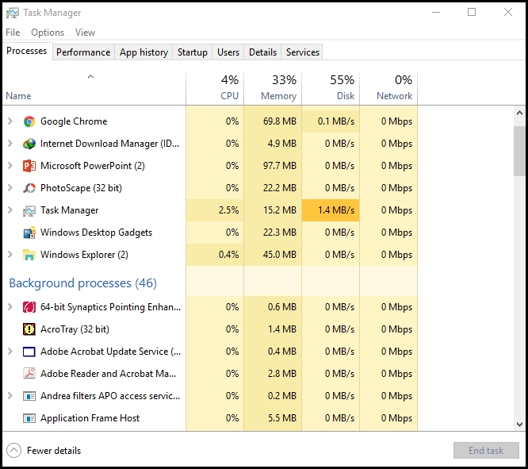
MEMORY MANAGEMENT INFORMATION FOR PROCESSES

Slide 15
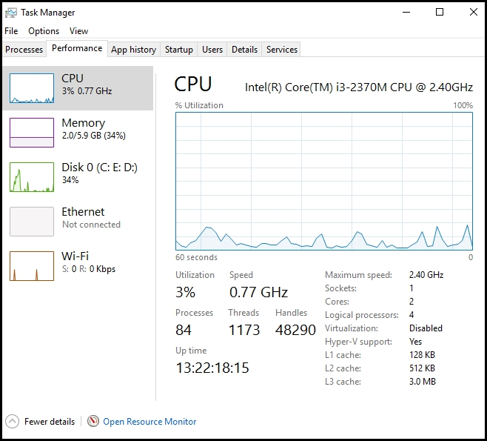
MEMORY MANAGEMENT INFORMATION FOR PROCESSES

Slide 16
MEMORY MANAGEMENT INFORMATION FOR DISK MANAGMENT
For memory management of disk or any permanent storage devices, the required information can be easily viewed using properties of relative drive.

Slide 17
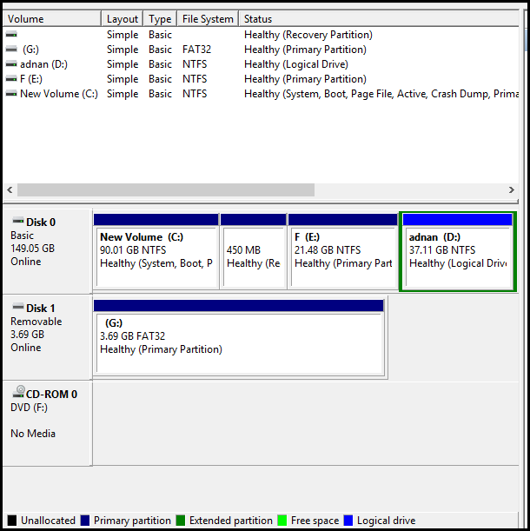
WHOLE STORAGE/DISK INFORMATION
Go to: My computer>Mange>Disk Manage

Slide 18
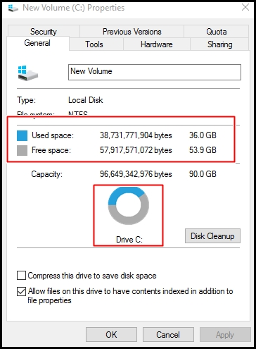
DRIVE INFORMATION

Slide 19
Memory Management Techniques for processes and Disks

Slide 20
Memory Management Techniques for processes and Disks
For both processes and permanent storage systems, we need to allocate memory.
There are techniques and different ways in which both things are handled.
We are first going to look into methods and algorithms for memory allocation for processes handling.

Slide 21
Memory Management Techniques for Processes

Slide 22
Memory Management Techniques for Processes
We will study following methods and algorithms for memory management regarding process handling.
Data Compaction Method (during swapping)
Memory allocation for processes:
First Fit (FF)
Next Fit (NF)
Best Fit (BF)
Worst Fit (WF)

Slide 23
DATA COMPACTION METHOD DURING SWAPPING

Slide 24
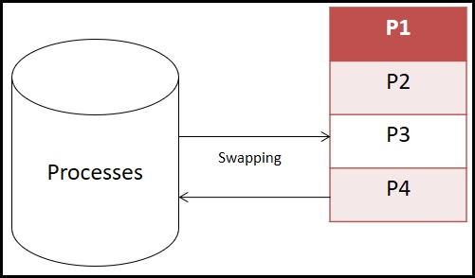
DATA COMPACTION: RECALL
Definition: Swapping consists of bringing each process in the memory, running it for a while and then putting it back on the disk.

Slide 25
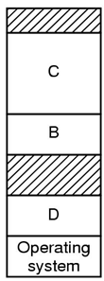
DATA COMPACTION
Definition: When swapping creates multiple holes in memory, it is possible to combine then into one big hole and then moving all the processes one by one downwards. This technique is called data compaction.
C
B
D
Operating system
Data Compaction

Slide 26
DATA COMPACTION
How much memory should be allocated for a process when it is swapped in?
OS allocates exactly what is needed if process is of fixed size.
If a hole is adjacent to the process, it can be allocated and the process allowed to grow into the hole.

Slide 27
DATA COMPACTION
What if the process is adjacent to another process ?
The growing process will have to be moved to another available hole large enough for it.
One or more processes will have to be swapped out to create large enough hole.
What if a process cannot grow in memory and the swap area on the disk is full?
Process will have to wait.
It will be killed

Slide 28
Process Memory Allocation Algorithms

Slide 29
Process Memory Allocation Algorithms
Just like we studied algorithms to avoid deadlocks among processes, we need algorithms to allocate memory to the processes.

Slide 30
Process Memory Allocation Algorithms
These algorithms helps an Operating system to decide which free block to allocate to a process.
These algorithms are used to allocate memory for newly created process or existing process swapped in from the disk.

Slide 31
Process Memory Allocation Algorithms
We will study following algorithms:
First Fit (FF)
Next Fit (NF)
Best Fit (BF)
Worst Fit (WF)

Slide 32
First Fit(FF) Algorithm

Slide 33
FIRST FIT(FF)
  Definition: This algorithm scans memory form the beginning and chooses the first available block that is large enough for the processes to fit in.

Slide 34
FIRST FIT(FF)
The memory manager scans along the list of segments until it finds a hole that is big enough to fit the process in the memory.
The hole is then broken up into two pieces, one for the process and one for unused memory.
Next time it is called to find a hole, it starts searching the list from the beginning.

Slide 35
FIRST FIT(FF):EXAMPLE
    Scan all memory holes and place process in the first memory bin large enough to hold it
A
B
C
D
E
F
Each process will be fitted into the first memory bin(A) that has room for it.
6
5
4
3
3
3
2
2
1

Slide 36
FIRST FIT(FF):EXAMPLE
4
A
B
C
D
E
F
The first process fits into the first memory bin
6
5
3
3
3
2
2
1

Slide 37
FIRST FIT(FF):EXAMPLE
1
4
A
B
C
D
E
F
The second process(1-Light blue) fits into the first memory bin(A).
6
5
3
3
3
2
2

Slide 38
FIRST FIT(FF):EXAMPLE
2
1
4
2
A
B
C
D
E
F
The third process(2-Dark blue) will try to fit in first memory bin, but there is space in second memory bin(B), so it will fit there.
6
5
3
3
3
2

Slide 39
FIRST FIT(FF):EXAMPLE
5
5
1
5
4
2
A
B
C
D
E
F
The third memory bin(C) is the first one where process 5 will fit in
6
3
3
3
2

Slide 40
FIRST FIT(FF):EXAMPLE
3
1
3
5
4
2
A
B
C
D
E
F
The second memory bin(B) has room for the process 3(red)
6
3
3
2

Slide 41
FIRST FIT(FF):EXAMPLE
2
2
2
1
3
5
4
2
2
A
B
C
D
E
F
The fourth bin(D) is the first one with room for the next process(2-purple)
6
3
3

Slide 42
FIRST FIT(FF):EXAMPLE
3
3
3
1
3
5
3
4
2
2
A
B
C
D
E
F
The next process(3-Dark green) also fits in the fourth bin(D)
6
3

Slide 43
FIRST FIT(FF):EXAMPLE
6
6
6
6
6
1
3
5
3
4
2
2
A
B
C
D
E
F
There is no room for process 6-(orange) until it reaches fifth memory bin(E), where it finally will fit in.
3

Slide 44
FIRST FIT(FF):EXAMPLE
3
3
3
3
3
6
1
3
5
3
4
3
2
2
A
B
C
D
E
F
Process 3- (Light Green) will find space in sixth memory bin(F).

Slide 45
FIRST FIT(FF):EXAMPLE
6
1
3
5
3
4
3
2
2
A
B
C
D
E
F
Final memory allocation for all the process.

Slide 46
Next Fit(NF) Algorithm

Slide 47
NEXT FIT(NF)
  We start to search for the free memory from the last point we stopped.
  For the first time, it just looks like first fit but generally from the second time it will start to search from the last position it stopped before.
  Scans memory from the location of the last placement.

Slide 48
BEST FIT(BF) Algorithm

Slide 49
BEST FIT(BF)
It searches the entire list that is close to the actual size needed.
It searches the entire list, from beginning to end and takes the smallest hole that is sufficient.
Scan all bins and place item in bin with tightest fit (will be fullest after item is placed there)

Slide 50
BEST FIT(BF)
2
1
3
4
5
6
A
B
C
D
E

Slide 51
BEST FIT(BF)
3
2
3
6
5
4
2
3
1
A
B
C
D
E
F
Same process allocation by Best fit Algorithm

Slide 52
WORST FIT(WF) Algorithm

Slide 53
WORST FIT(WF)
The algorithm searches for free-space in memory in which it can store the desired information.
The algorithm selects the largest possible free space that the information can be stored on (i.e. that is bigger than the information needing to be stored) and stores it there.
It happens in case where processes are expected to grow in future.
This is directly opposed to the best fit algorithm which searches the memory in much the same way as before.

Slide 54
Worst FIT(WF)
6
5
3
3
2
1
A
B
C
D
E
F
Process allocation by Worst Fit Algorithm

Slide 55


